Slide 1
Kwakiutl Tribe
By Ellen Link

Slide 2
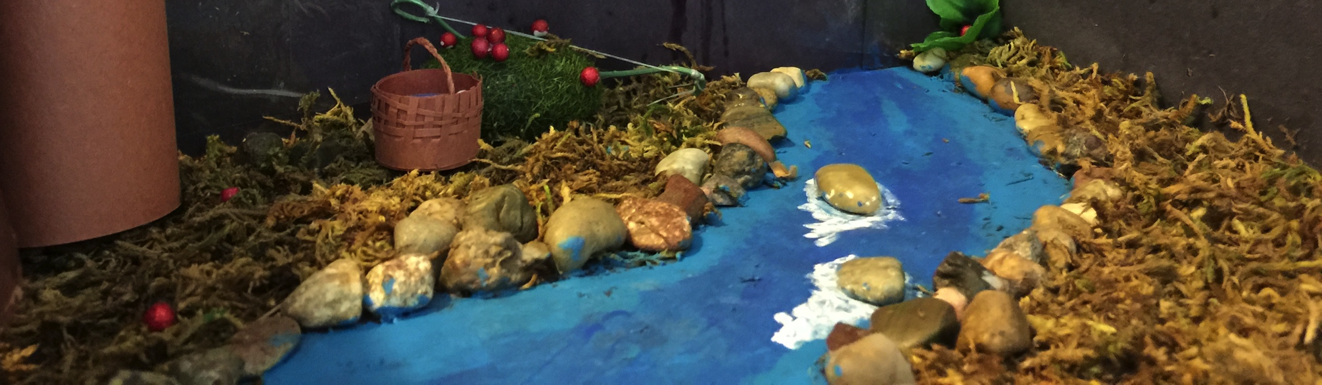
Included in the Presentation
Map of the Kwakiutl
Timeline of the Kwakiutl
Pictures of the Kwakiutl Diorama
Northwest Coast of North America

Slide 3
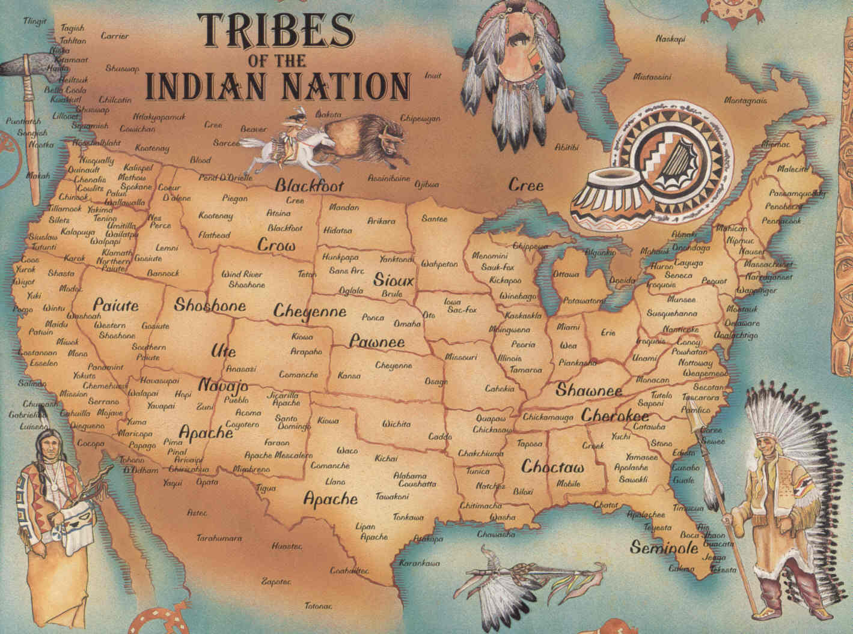
The Kwakiutl Tribe lived in Canada, Oregon, Washington, and British Columbia. This is the Northwest Coast.
Ellen Link – Map of the Kwakiutl

Slide 4
Kwakiutl Timeline
Spanish explorers Dionisio Alcalá-Galiano and Cayetano Valdés, and British Captain George Vancouver encountered the south Kwakwaka'wakw groups.
The Canadian government bans Potlatch, a gift-giving feast of the tribes. Potlatch is a tradition where the rich people give goods to other people.
The Kwakiutl tribe
Meet the first European Explorers
Fort Rupert was established which became a trading post for The Kwakiutl Tribe
And other tribes and settlers.
1951
Ellen Link – Map of the Kwakiutl
The Canadian government removes the ban on Potlatch.
1780
1884
1849
1792
Sources: http://thecanadianencyclopedia.com/ http://www.encyclopedia.com/

Slide 5
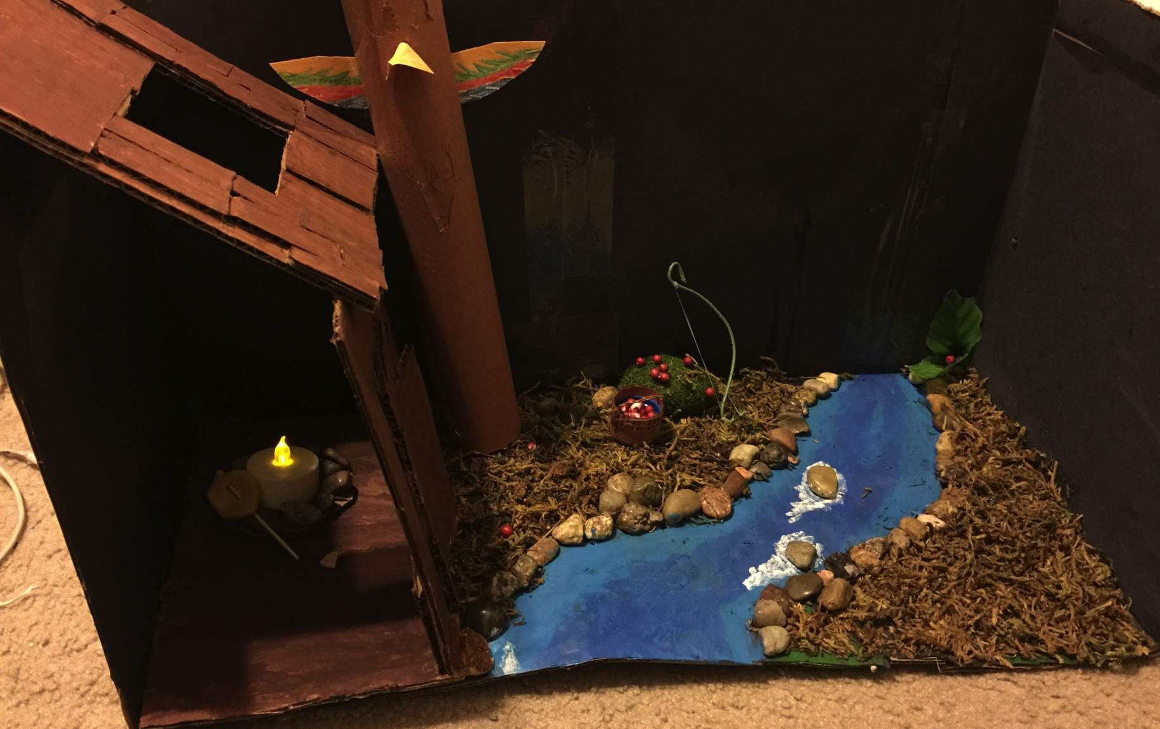
Kwakiutl Diorama
Cedar Totem for the Clan
Long House with Venting for Fire
Bow And Arrow
Wild Berries
Fish on Spear near Fire
Coastal Waters

Slide 6
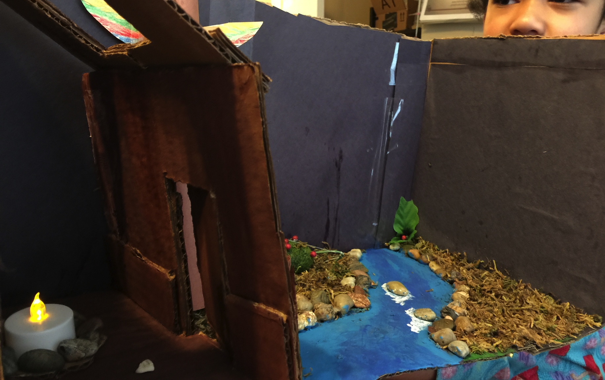
Kwakiutl Diorama
My Face.
Cedar Plank Wall With a Door.
Fire.

Slide 7

Kwakiutl Diorama
Cedar Totem For The Clan.
Wild berry bush
Basket

